Slide 1
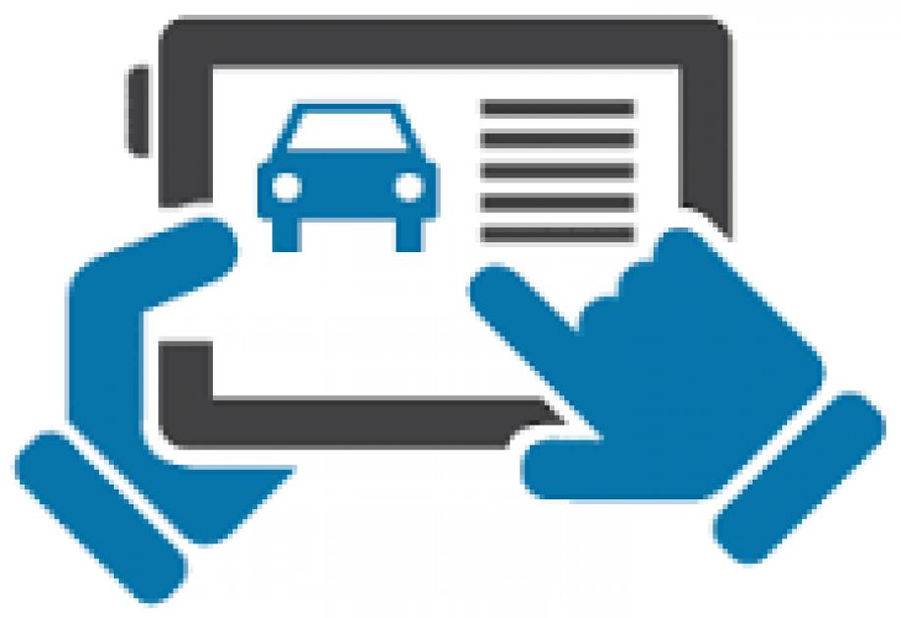

Vehicle Requisition System
A Software to make the Vehicle Requisition process smarter

Slide 2
Introducing: a new software program
A tool for simplifying Vehicle Requisition Process and to reduce time consumption .
Primarily for employees who wants to request for a vehicle for requisition .
Using MVC platform and computerized automated technologies .
It reduces the need for paper works .
Developed by team Gama of BKIICT ASP.Net Batch-1 students .

Slide 3
How the progam will work
It is a web based application .
Employee request for requisition using their web browser through internet/internal .
A controller will get the request through our system and will assign a vehicle against the request .
After successful vehicle assigning process system will send notification to the requester and the driver through Email / SMS and also in the system .
Controller, employee and driver can also communicate with each other against any requisition during different state of requisition . It will eliminate communication gap between each other.
Controller can generate different reports .

Slide 4
Process flow
Respond of the Controller
Request Submitted by Employee
Request sent to a Controller as a new Request
Notification to requestor and driver
Assign / Reassign

Slide 5
System Overview

Slide 6
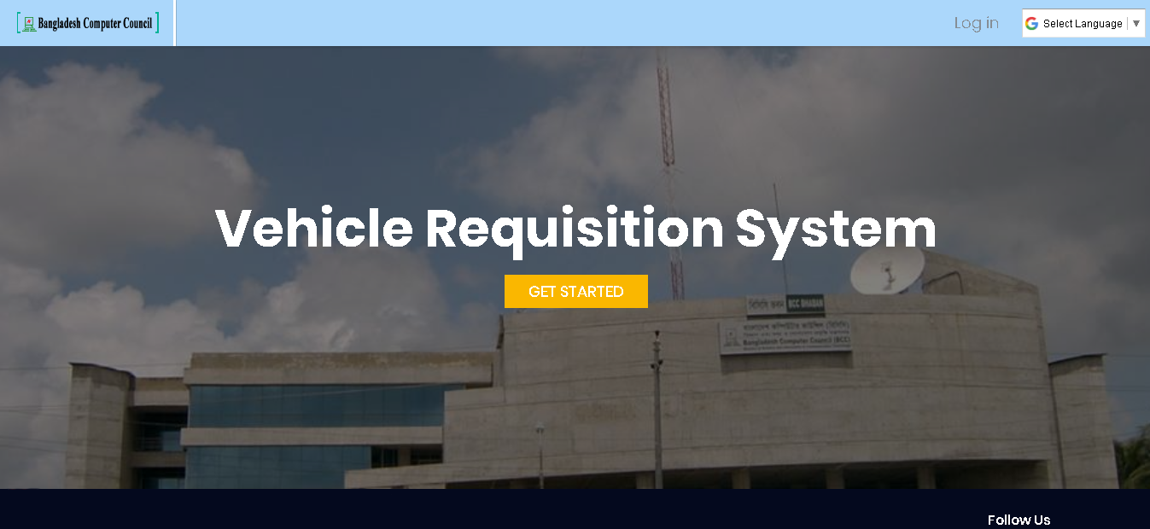
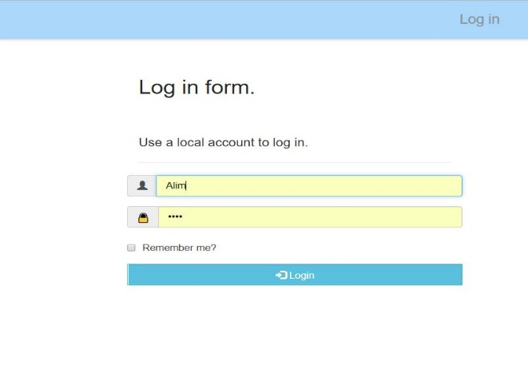
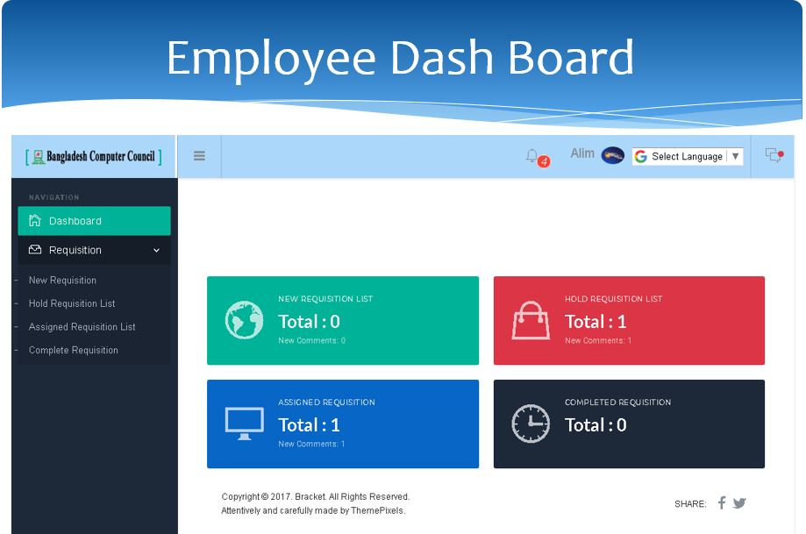
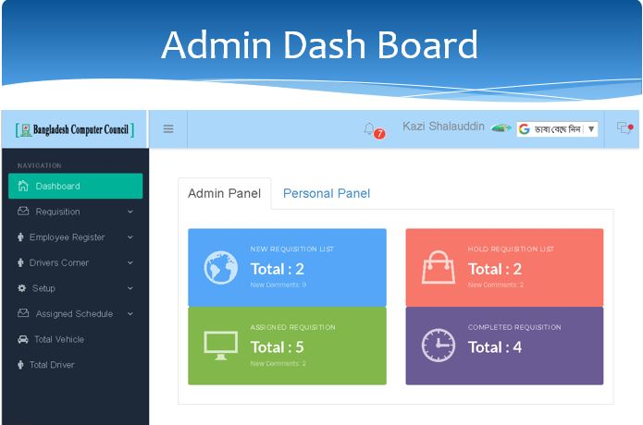
Log-In Operation
Log In
Successful Log In

Slide 7
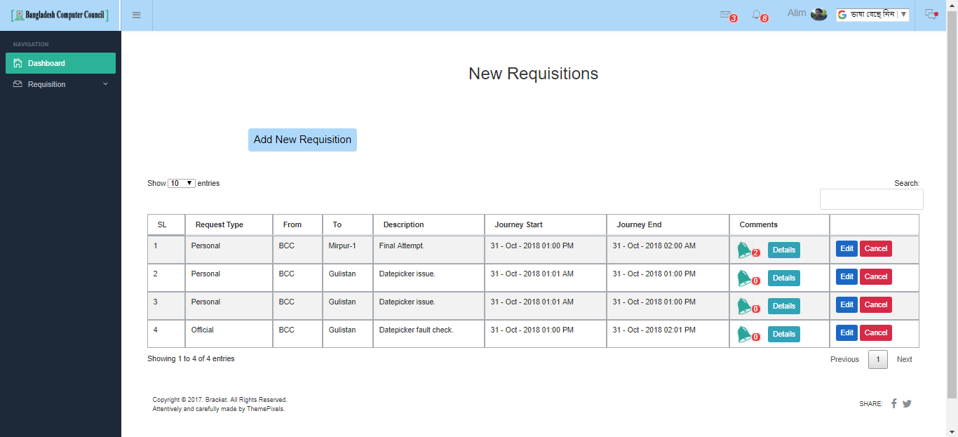
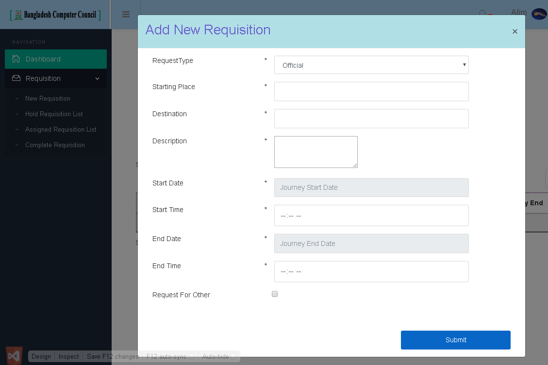
Requisition Requests Process
Add New Requisition
Submit Request

Slide 8
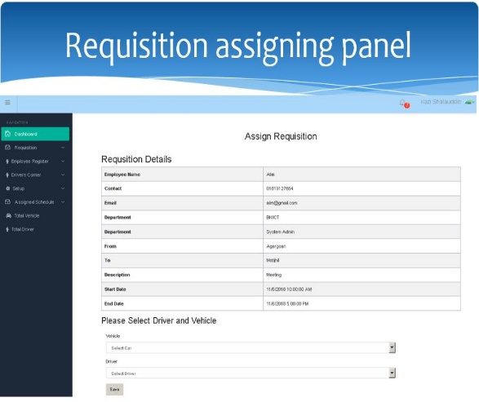
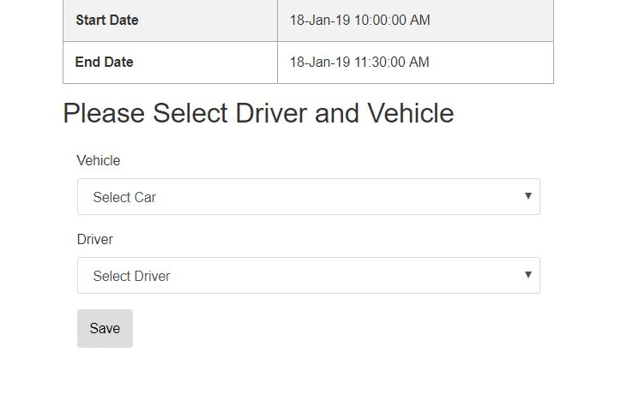
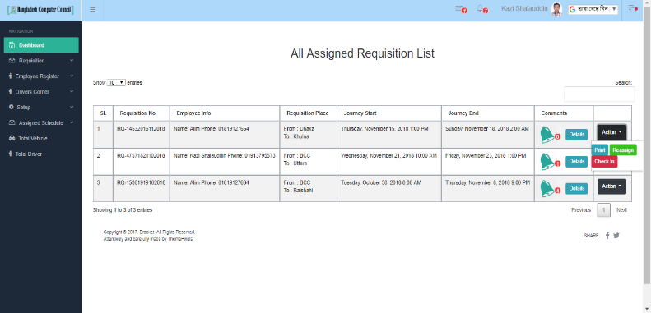
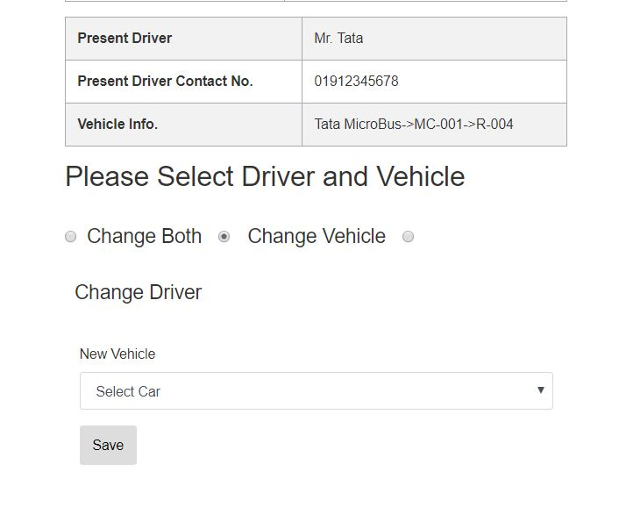
Request Assign/Reassign Process
Request Assign Panel
Request Assigned List
Reassign

